Slide 1

UNIT-1
Syntax and Semantics
Prepared By:
Dr. Archana Sharma
archana@delhitechnicalcampus.ac.in

Slide 2
What is Regular grammar?
a) Context free grammar
b) Non context free grammar
c) English grammar
d) None of the mentioned
Let L={ab,aa,baa}
Which of the following string are not in L*
Abaabaaabaa
Aaaabaaaa
Baaaabaaab
baaaaabaa
Write a grammar for the following :
{ w ∈ {0, 1} ∗ | w contains at least three 1s }
{ w ∈ {0, 1}∗ I the length of w is odd and the middle symbol is 0 }

Slide 3
{ w ∈ {0, 1} ∗ | w contains at least three 1s }
G = (V, Σ, R, S) with set of variables V = {S, X}, where S is the start variable; set of terminals Σ = {0, 1}; and rules
S → X1X1X1X
X → 0X | 1X | ε
{ w ∈ {0, 1}∗
| the length of w is odd and the middle symbol is 0 }
G = (V, Σ, R, S) with set of variables V = {S}, where S is the start
variable; set of terminals Σ = {0, 1}; and rules
S → 0S0 | 0S1 | 1S0 | 1S1 | 0

Slide 4
Find Out the Error:
if (number=200)
17 count << "number is equal to 20";
18 else
19 count << "number is not equal to 200"
int main()
{
return 0;
cout << “Hello World";
}
int main()
printf("Geeks for Geeks");
return 0;
}
int a = "hello";
int main()
{
int x = 10;
b = 20, c;
x + y = c;
printf("%d", c);
return 0;
}
String s = "...";
int a = 5 - s;

Slide 5
#include <stdio.h>
int main()
{
int sum=0; // variable initialization
int k=1;
for(int i=1;i<=10;i++);
{
sum=sum+k;
k++;
}
printf("The value of sum is %d", sum);
return 0;
}
#include <stdio.h>
int main()
{
int a,b,c;
a=2;
b=3;
c=1;
a+b=c; // semantic error
return 0;
}
int a[10];
a[10] = 34;

Slide 6
Variable an Expression
a = 3
b = 9
if b % a == 0 :
print ("b is divisible by a")
elif b + 1 == 10:
print ("Increment in b produces 10")
else:
print ("You are in else statement")
In Python
a = 3
A = 4
print (a)
print (A)
int main()
{
cin>>x;
cout<<x;
}
int count;
while(count<100)
{
cout<<count;
}

Slide 7
The Concept of Binding
A binding is an association, such as between an attribute and an entity, or between an operation and a symbol
Binding time is the time at which a binding takes place.

Slide 8
Static and Dynamic Binding
A binding is static if it first occurs before run time and remains unchanged throughout program execution.
A binding is dynamic if it first occurs during execution or can change during execution of the program

Slide 9
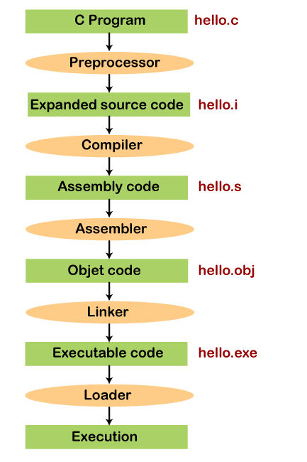

Slide 10
Binding for functions means that wherever there is a function call, the compiler needs to know which function definition should it call?
This depends upon the signature of each function declaration & the arguments that it is taking.
Also, compiler needs to know when this function binding happens (at compile/run time).
Example
myFunc(int x, int y);
myFunc(x);
myFunc(float x, float y); these are function declarations.
The compiler needs to know which declaration should it refer to whenever it sees a function call.
Also when it should make the decision. At runtime or compile time?
For Variables –
It needs to know which variable should be referred to as there may be variables with the same names but different types like int, float, double

Slide 11
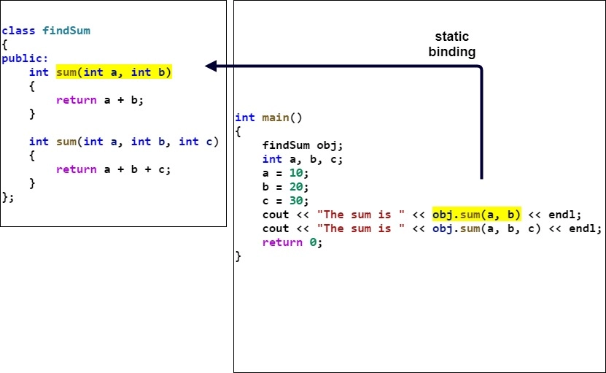

Slide 12
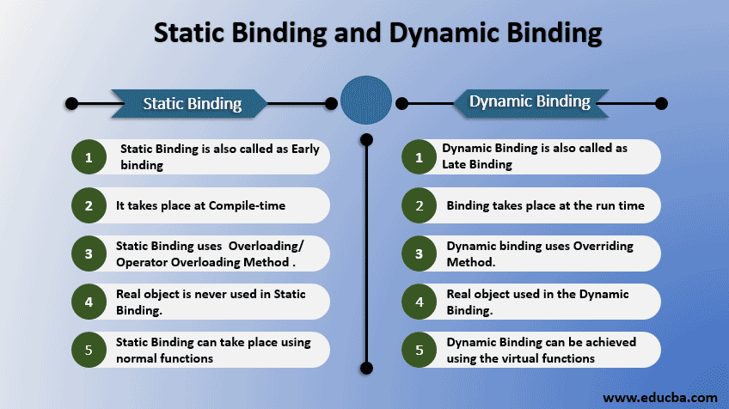

Slide 13
class Base
{
public:
void show() { cout<<" In Base \n"; }
};
class Derived: public Base
{
public:
void show() { cout<<"In Derived \n"; }
};
int main(void)
{
Base *bp = new Derived;
bp->show();

Slide 14
class BaseClass
{
public:
virtual void Display()
{
cout << "\nThis is Display() method"
" of BaseClass";
}
void Show()
{
cout << "\nThis is Show() method "
"of BaseClass";
}
};
class DerivedClass : public BaseClass
{
public:
// Overriding method - new working of
// base class display method
void Display()
{
cout << "\nThis is Display() method"
" of DerivedClass";
}
};
// Driver code
int main()
{
DerivedClass dr;
BaseClass &bs = dr;
bs.Display();
dr.Show();
}

Slide 15
Type Binding
How is a type specified?
When does the binding take place?
If static, the type may be specified by either an explicit or an implicit declaration

Slide 16
Explicit/Implicit Declaration
An explicit declaration is a program statement used for declaring the types of variables
An implicit declaration is a default mechanism for specifying types of variables (the first appearance of the variable in the program)
FORTRAN, PL/I, BASIC, and Perl provide implicit declarations
  Advantage: writability
  Disadvantage: reliability (less trouble with Perl)

Slide 17
Categories of Variables by Lifetimes
A storage class represents the visibility and a location of a variable. It tells from what part of code we can access a variable.
Static--bound to memory cells before execution begins and remains bound to the same memory cell throughout execution, e.g., C and C++ static variables
  Advantages: efficiency (direct addressing), history- sensitive subprogram support
  Disadvantage: lack of flexibility (no recursion)

Slide 18
Storage Classes | Names of class | Storage Place | Default Value | Scope | Lifetime
auto | Automatic | RAM | Garbage Value | Local | Within function
extern | External | RAM | Zero | Global | Till the end of the main program Maybe declared anywhere in the program
static | Static | RAM | Zero | Local | Till the end of the main program, Retains value between multiple functions call
register | Register | Register | Garbage Value | Local | Within function

Slide 19
Static Scope
Scope of a static variable is that it retains its value throughout the program and in between function calls.
Static variables are initialized only once.

Slide 20
#include<stdio.h>
main ( ){
inc ( );
inc ( );
inc ( );
}
inc ( ){
static int i =1;
printf ("%d", i);
i++;
}
Output :

Slide 21
Register
The keyword is register.
Register variable values are stored in CPU registers, rather than in memory where, normal variables are stored.
Registers are temporary storage units in CPU.
They allow faster access time for register variables than normal variables.
#include<stdio.h> int main()
{ register int a; printf("%d",a); }

Slide 22
#include<stdio.h>
int main(){
register int i = 10;
int *p;
//int *p = &i;
printf("Value of i: %d", *p);
printf("Address of i: %u", p);
}
Output :

Slide 23
Blocks
Examples:
C++:
while (...) {
int index;
...
}
Ada:
declare Temp : Float; begin
...
end

Slide 24
Evaluation of Static Scoping
Assume MAIN calls A and B A calls C and D
B calls A and E
MAIN
MAIN
A
C
A
B
D
C
D
E
B
E

Slide 25
Static Scope Example
MAIN
MAIN
A
B
A
B
C
D
E
C
D
E

Slide 26
Static Scope (continued)
Suppose the spec is changed so that D must now access some data in B
Solutions:
  Put D in B (but then C can no longer call it and D cannot access A's variables)
  Move the data from B that D needs to MAIN (but then all procedures can access them)
Same problem for procedure access
Overall: static scoping often encourages many globals

Slide 27
Dynamic Scope
Based on calling sequences of program units, not their textual layout (temporal versus spatial)
References to variables are connected to declarations by searching back through the chain of subprogram calls that forced execution to this point

Slide 28
Scope Example
Big
- declaration of X Sub1
- declaration of X -
...
call Sub2
...
Big calls Sub1 Sub1 calls Sub2 Sub2 uses X
Sub2
...
- reference to X -
...
...
call Sub1
…

Slide 29
Scope Example
Static scoping
  Reference to X is to Big's X
Dynamic scoping
  Reference to X is to Sub1's X
Evaluation of Dynamic Scoping:
  Advantage: convenience (called subprogram is executed in the context of the caller)
  Disadvantage: poor readability

Slide 30
Scope and Lifetime
Scope and lifetime are sometimes closely related, but are different concepts
Consider a static variable in a C or C++ function

Slide 31
Referencing Environments
The referencing environment of a statement is the collection of all names that are visible in the statement
In a static-scoped language, it is the local variables plus all of the visible variables in all of the enclosing scopes
A subprogram is active if its execution has begun but has not yet terminated
In a dynamic-scoped language, the referencing environment is the local variables plus all visible variables in all active subprograms

Slide 32
Named Constants
A named constant is a variable that is bound to a value only when it is bound to storage
Advantages: readability and modifiability
Used to parameterize programs
The binding of values to named constants can be either static (called manifest constants) or dynamic
Languages:
  FORTRAN 95: constant-valued expressions
  Ada, C++, and Java: expressions of any kind
  C# has two kinds, readonly and const
    the values of const named constants are bound at compile time
    The values of readonly named constants are
Copyrig^{d}h^{y}t^{n}©^{am}2^{ic}0ª0^{l}7^{ly} A^{bo}d^{u}d^{n}i^{d}son- Wesley. All rights reserved.

Slide 33
Variable Initialization
The binding of a variable to a value at the time it is bound to storage is called initialization
Initialization is often done on the declaration statement, e.g., in Java
int sum = 0;

Slide 34
Type Checking
Generalize the concept of operands and operators to include subprograms and assignments
Type checking is the activity of ensuring that the operands of an operator are of compatible types
A compatible type is one that is either legal for the operator, or is allowed under language rules to be implicitly converted, by compiler- generated code, to a legal type
– This automatic conversion is called a coercion.
A type error is the application of an operator to an operand of an inappropriate type

Slide 35
Type Checking (continued)
If all type bindings are static, nearly all type checking can be static
If type bindings are dynamic, type checking must be dynamic
A programming language is strongly typed if type errors are always detected
Advantage of strong typing: allows the detection of the misuses of variables that result in type errors

Slide 36
Strong Typing
Language examples:
FORTRAN 95 is not: parameters, EQUIVALENCE
C and C++ are not: parameter type checking can be avoided; unions are not type checked
Ada is, almost (UNCHECKED CONVERSION is loophole)
(Java and C# are similar to Ada)

Slide 37
Strong Typing (continued)
Coercion rules strongly affect strong typing-- they can weaken it considerably (C++ versus Ada)
Although Java has just half the assignment coercions of C++, its strong typing is still far less effective than that of Ada

Slide 38
Name Type Equivalence
Name type equivalence means the two variables have equivalent types if they are in either the same declaration or in declarations that use the same type name
Easy to implement but highly restrictive:
  Subranges of integer types are not equivalent with integer types
  Formal parameters must be the same type as their corresponding actual parameters

Slide 39
Structure Type Equivalence
Structure type equivalence means that two variables have equivalent types if their types have identical structures
More flexible, but harder to implement

Slide 40
Type Equivalence (continued)
Consider the problem of two structured types:
  Are two record types equivalent if they are structurally the same but use different field names?
  Are two array types equivalent if they are the same except that the subscripts are different?
(e.g. [1..10] and [0..9])
  Are two enumeration types equivalent if their components are spelled differently?
  With structural type equivalence, you cannot differentiate between types of the same structure
(e.g. different units of speed, both float)

Slide 41
Variable Attributes: Scope
The scope of a variable is the range of statements over which it is visible
The nonlocal variables of a program unit are those that are visible but not declared there
The scope rules of a language determine how references to names are associated with variables

Slide 42
int main()
{
menu();
}
void menu()
{
...
}
int array[10];
//...
for(int x=1; x<=10; x++)
cout<<array[x];
double half = 1/2;
Cout<<half;

Slide 43
Typecasts
int main()
{
// Given a & b
int a = 15, b = 2;
char x = 'a';
double div;
div = (double)a / b;
x = x + 3;
printf("The result of Implicit typecasting is %c\n", x);
printf("The result of Explicit typecasting is %f", div);
return 0;
}
In Python
x = int(1) # x will be 1
y = int(2.8) # y will be 2
z = int("3") # z will be 3
int main()
{
int x = 10;
char y = 'a';
x = x + y;
float z = x + 1.0;
cout << "x = " << x << endl
<< "y = " << y << endl
<< "z = " << z << endl;
return 0;
}

Slide 44
L Value and R Value
int main () {
// declare simple variables
int i;
double d;
// declare reference variables
int& r = i;
double& s = d;
i = 5;
cout << “Value of i : ” << i << endl;
cout << “Value of i reference : ” << r << endl;
d = 11.7;
cout << “Value of d : ” << d << endl;
cout << “Value of d reference : ” << s << endl;
return 0;
}
int x, y;
( x < y ? y : x) = 0;

Slide 45
Which statement should not be used when working with loops in C++?
goto
break
continue
return
Which of the following is true of the break statement?
It stores all variable values
It skips to the last line of the loop
It ends all loop processing
It clears global variables and objects
int main() {
int number, positiveCount = 0, negativeCount = 0;
cout << "Enter numbers (0 to stop): ";
while (cin >> number && number != 0) {
if (number > 0) {
positiveCount++;
} else {
negativeCount++;
}
}
cout << "Positive numbers: " << positiveCount << endl;
cout << "Negative numbers: " << negativeCount << endl;
return 0; }

Slide 46
# Python Code
# Create a tuple named 'numbers' containing integer values from 1 to 9
numbers = (1, 2, 3, 4, 5, 6, 7, 8, 9)
# Initialize counters for counting odd and even numbers
count_odd = 0
count_even = 0
# Iterate through each element 'x' in the tuple 'numbers'
for x in numbers:
# Check if the current number 'x' is even by evaluating 'not x % 2'
if not x % 2: # If 'x' modulo 2 equals 0, it's even
# Increment the count of even numbers
count_even += 1
else:
# If 'x' modulo 2 doesn't equal 0, it's odd; increment the count of odd numbers
count_odd += 1
# Print the total count of even and odd numbers
print("Number of even numbers:", count_even)
print("Number of odd numbers:", count_odd)

